Slide 1
4. Bottlenecks and Solutions

Slide 2
System status
homogenous accelerators for all model training nodes
the on-device memory for each accelerator is limited
cross-machine GPU bandwidth <<< single machine GPUs bandwidth
the training job is exclusively running on the machines.
copying data host CPU ~ GPU << among GPUs transferring data
the GPU memory is rarer than the GPU computation cores

Slide 3
bottleneck
Communication bottlenecks in data parallel training
Leveraging idle links and host resources
On-device memory bottlenecks
Recomputation and quantization

Slide 4
• g_i: The local gradients that are generated from a single worker
• G: The globally synchronized gradients
• W: The number of parameters for the model weights
• N: The total number of workers
• BW_node: The cross-machine communication bandwidth
• BW_gpu: The pairwise GPU communication bandwidth within a single machine

Slide 5
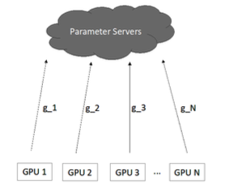
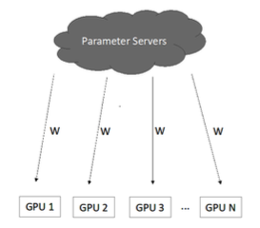



Communication bottlenecks in data parallel training
This model synchronization overhead is added to each training iteration. As reported by state-of-the-art research literature, the time cost for model synchronization can be up to 50% of the end-to-end DNN training time if we scale out to more than 50 GPUs. Therefore, this communication overhead is huge and makes GPU computation cores idle for 50% of the total training time.

Slide 6
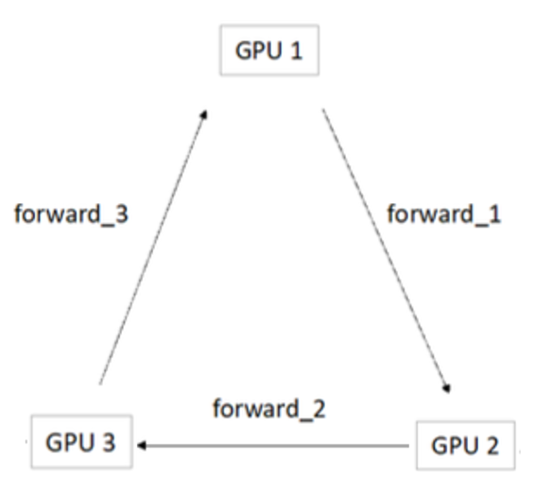



The All-Reduce architecture
forward_1 = g_1 ( GPU1 → GPU2)
forward_2 = g_1 + g_2 ( GPU2 → GPU3)
forward_3 = g_1 + g_2 + g_3 ( GPU3 → GPU1)
forward_1 = g_1 + g_2 + g_3 ( GPU1 → GPU2)
forward_2 = g_1 + g_2 + g_3 ( GPU2 → GPU3)
State-of-the-art literature reports similar model synchronization overhead to the parameter server architecture, which is up to 50% of the end-to-end deep neural network (DNN) training time. This overhead can be amplified if multiple GPUs/nodes share the same physical link (for example, multiple GPUs share the same PCI-e bus for model synchronization within a machine) due to network congestion.

Slide 7
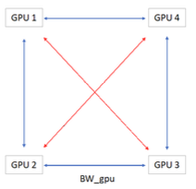
The inefficiency of state-of-the-art communication schemes
Ring All-Reduce scheme
- blue link : in used
- red link : unused

Slide 8
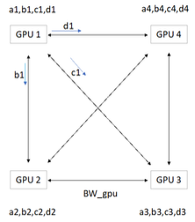


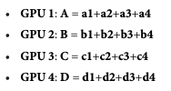
Leveraging idle links and host resources

Slide 9
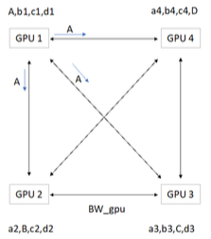
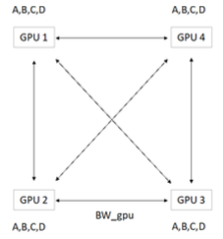

Leveraging idle links and host resources

Slide 10
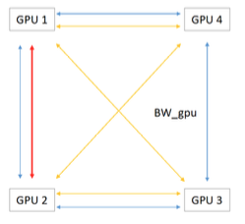
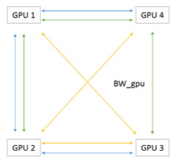


Leveraging idle links and host resources
Ring All-Reduce
Tree Ring All-Reduce

Slide 11
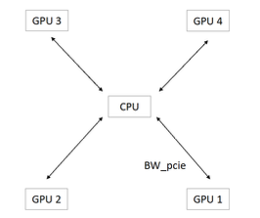

Hybrid data transfer over PCIe and NVLink
BW ratio : R = BW_NVLink / BW_PCIe
Transfer data over PCIe = 1/ (1+R) Transfer data over NVLink = R / (1+R)
NVIDIA DGX-1

